Slide 1

Mapping Your Stack
?
Adrian Cockcroft
@adrianco
AWS VP Cloud Architecture Strategy

Slide 2
Technology evolves, and our tech-stack choices need to be discussed, justified and decided.
Start with a few helpful questions…

Slide 3
What problem are you trying to solve?
HINT—Building or installing a framework is the wrong answer…
Something involving new user or business needs is a good answer:
Faster feature delivery?
International launch?
Lower cost?
Improved QoS?

Slide 4

What is the user need?
What problem are you trying to solve?
—
User need

Slide 5

User need
What is the user need?
What does the value chain look like?
What’s your time-to-value?
How is the value chain evolving?
Have you heard of Simon Wardley?

Slide 6
Leverage
Wardley Maps
Visualize evolution and innovate further up the value chain
Notes:
New Needs: IoT, analytics, social media monitoring, scale with number of interactions times number of products shipped, predictive modeling

Slide 7
Let’s look at your
Wardley Map
What’s your position and movement on the map?
Notes:
New Needs: IoT, analytics, social media monitoring, scale with number of interactions times number of products shipped, predictive modeling

Slide 8

OLD WORLD IT
Marketing analytics
Employees at work
Sales channels
Factories + supply chain

Slide 9

NEW WORLD IT
OLD WORLD IT
Marketing analytics
Employees at work
Sales channels
Factories + supply chain

Slide 10



Mobile employees
NEW WORLD IT
Employees at work
Online marketing
Social media
Continuous supply tracking
Factories + supply chain
Online sales + delivery
Just in time production
IoT connected things

Slide 11
Personalization
Customer analytics
New channels direct to customer
More things, more scale, rapid change
New Needs
Notes:
Education example
New World: Product is interactive online content, customer is end user. Result is a personal learning plan. Engagement and retention
New Needs: Personalization, customer tracking, new channels direct to consumer by passing existing institutions

Slide 12


Through 2021, 75% of digital leaders will dominate a disruptive market segment that did not exist prior to their ascendance.
Gartner, Predicts 2018: Digital Disruption – Predicting the Fundamental Shifts, 21 December 2017
Notes:
Education example
New World: Product is interactive online content, customer is end user. Result is a personal learning plan. Engagement and retention
New Needs: Personalization, customer tracking, new channels direct to consumer by passing existing institutions

Slide 13
AWS: Unblocking Innovation for Digital Transformation with Enterprise Customers

Slide 14




























































































































































AWS Enterprise Customers

Slide 15






















Digital Transformation is Key to Survival for Enterprises

Slide 16
Pathway for Digital Transformation
Speed
Scale
Strategic
!
Time to Value
Distributed Optimized Capacity
Critical Workloads Datacenter Replacement

Slide 17

Pathway for Digital Transformation
Speed
Scale
Strategic
Time to Value
The fast companies are
440x
faster than the slow
We found that, compared to low performers, high performers have:
46 times more frequent code deployments
440 times faster lead time from commit to deploy
170 times faster mean time to recover from downtime
5.0 times lower change failure rate (1/5 as likely for a change to fail)
!
Months
Hours
Distributed Optimized Capacity
Critical Workloads Datacenter Replacement
https://itrevolution.com/book/accelerate/

Slide 18
Pathway for Digital Transformation
Speed
Scale
Strategic
!
Time to Value
Distributed Optimized Capacity
Critical Workloads Datacenter Replacement

Slide 19
Pathway for Digital Transformation
Speed
Scale
Strategic
Distributed Optimized Capacity
Highly Scaled
Distributed for Availability
Cost Optimized High Utilization
Cloud Native Architecture
!
Time to Value
Critical Workloads Datacenter Replacement

Slide 20
Cloud Native Architecture
Principles and Practices

Slide 21
Datacenter Native
Architecture
DATACENTER

Slide 22
Datacenter Native
Infrastructure
Architecture
Lives for years
DATACENTER

Slide 23

Cloud Migration
Pay as you go
Pay up front and depreciate over three years
Pay a month later for the number of seconds used
Applications and data
DATACENTER

Slide 24
Cloud Native Principle
Pay for what you used last month
Not what you guess you will need next year

Slide 25




File tickets and wait for every step
Self service, on-demand, no delays
!
!
!
VS

Slide 26
File tickets and wait for every step
Self service, on-demand, no delays
!
!
!
Deploy by filing a ticket and waiting weeks or months
Deploy by making an API call self service within minutes
VS

Slide 27
Cloud Native Principle
Self service, API driven, automated
Move from request tickets at every step to a tracking ticket that records what happened

Slide 28
Cloud Native Principle
Instant globally distributed deployments and data by default

Slide 29
Elasticity
DATACENTER
CLOUD
Hard to get over 10% utilization— need extra capacity in case of peak
Target over 40% utilization— no capacity overload issues

Slide 30
Autoscaling for predictable heavy workloads
Serverless for spiky workloads with idle periods

Slide 31
Cloud Native Principle
Turn it off when it’s idle
Many times higher utilization
Huge cost savings
Avoids capacity overloads

Slide 32
Cloud Native Principle
Immutable code
Automated builds
Ephemeral instances, containers, and functions
Blue–Green deployments
Versioned services

Slide 33
Cloud Native Principles
Pay as you go, afterwards
Self service—no waiting
Globally distributed by default
Cross-zone/region availability models
High utilization—turn idle resources off
Immutable code deployments

Slide 34
A Specific Example:
Travel Search

Slide 35
What problem are you trying to solve?
Users want:
Faster personalized search
Business wants:
Faster feature releases
Lower costs

Slide 36
User need
What is the user need?
What does the value chain look like?
Search Interface
Travel Datastore
Compute and Storage

Slide 37
Example created using
wardleymaps.com

Slide 38
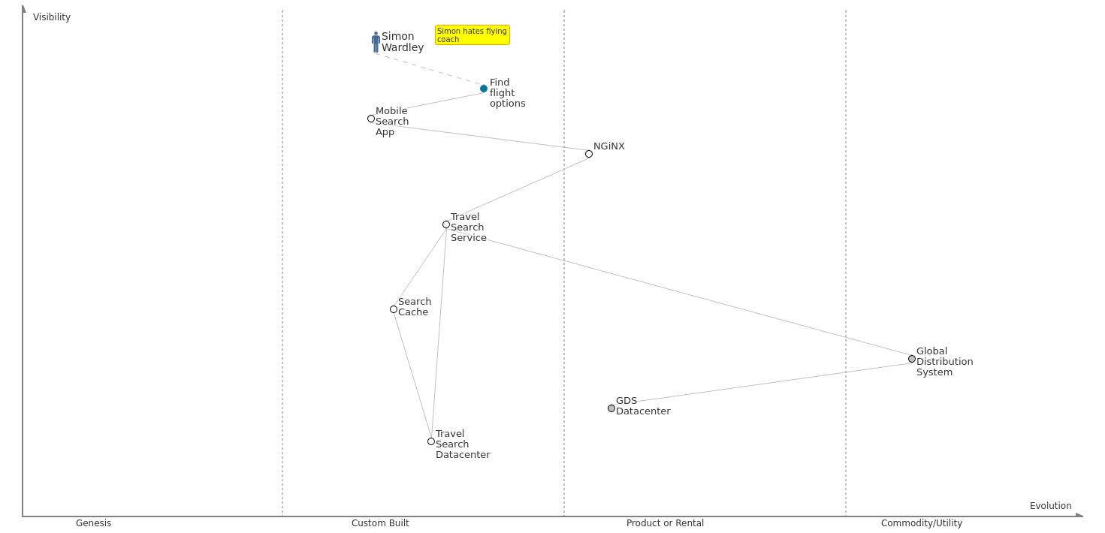
Travel search – starting point
Notes:
New Needs: IoT, analytics, social media monitoring, scale with number of interactions times number of products shipped, predictive modeling

Slide 39
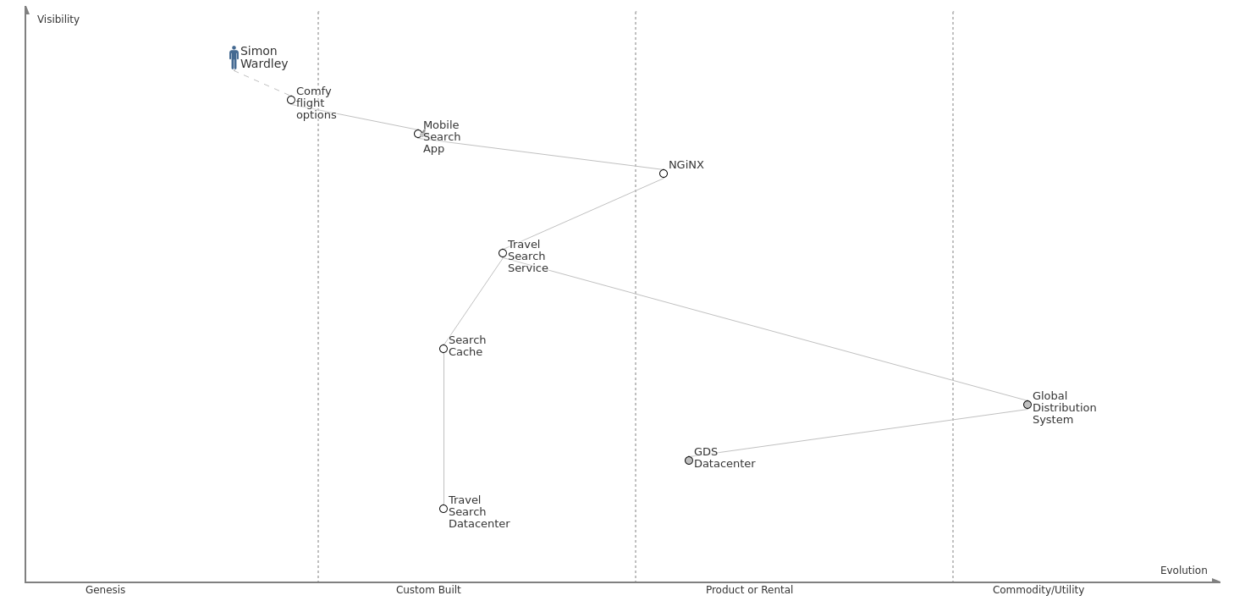
Travel search – comfy seat search
Notes:
New Needs: IoT, analytics, social media monitoring, scale with number of interactions times number of products shipped, predictive modeling

Slide 40
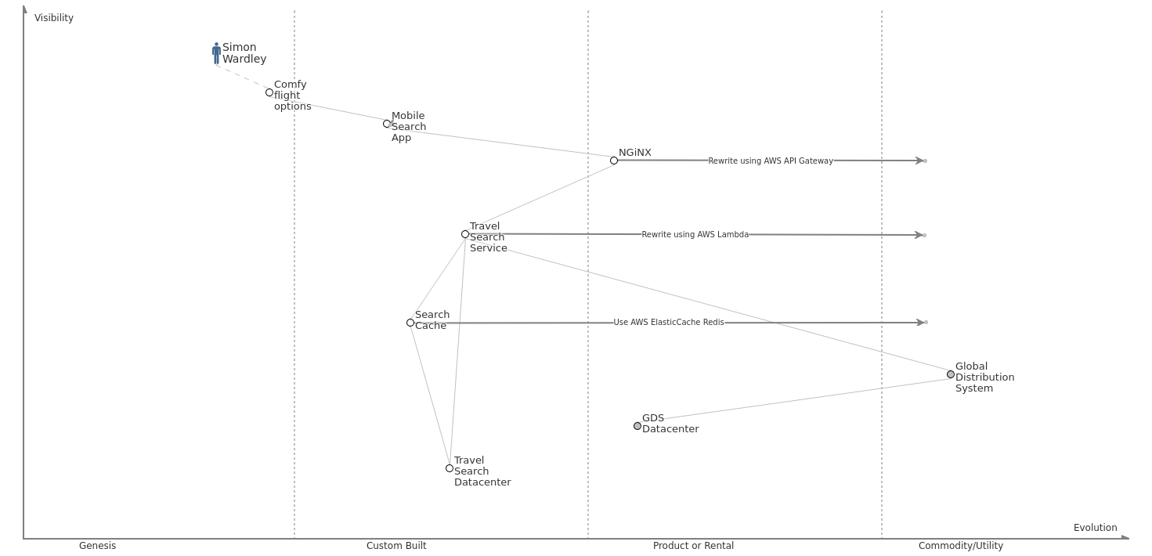
Travel search – reduce search cost
Notes:
New Needs: IoT, analytics, social media monitoring, scale with number of interactions times number of products shipped, predictive modeling

Slide 41
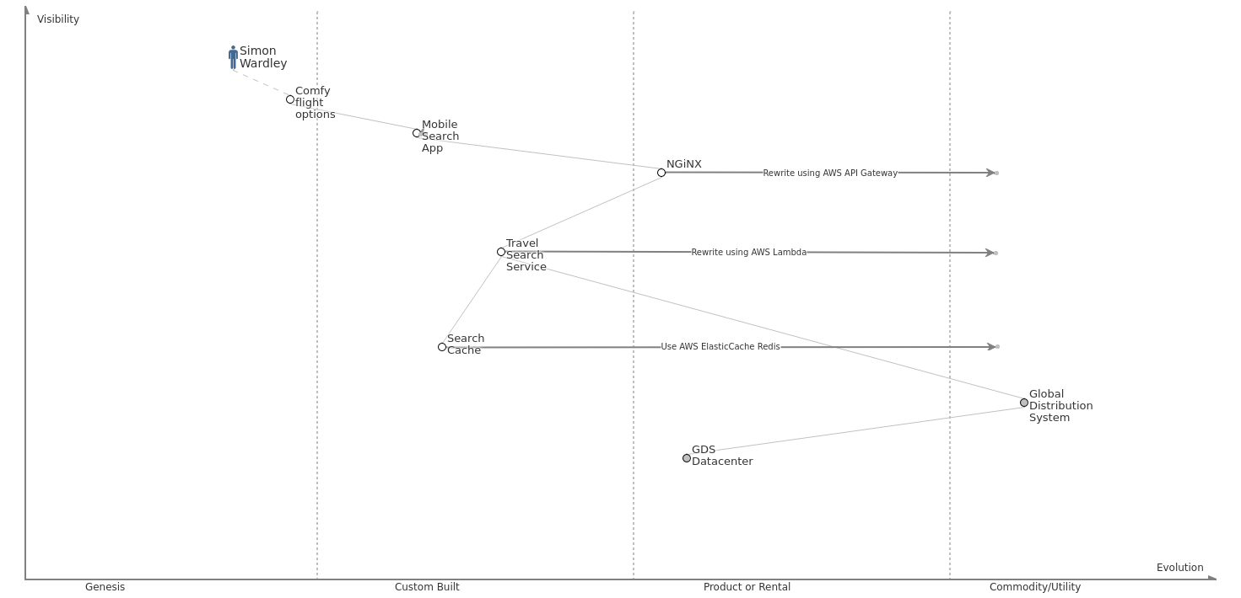
Travel search – exit datacenter
Notes:
New Needs: IoT, analytics, social media monitoring, scale with number of interactions times number of products shipped, predictive modeling

Slide 42
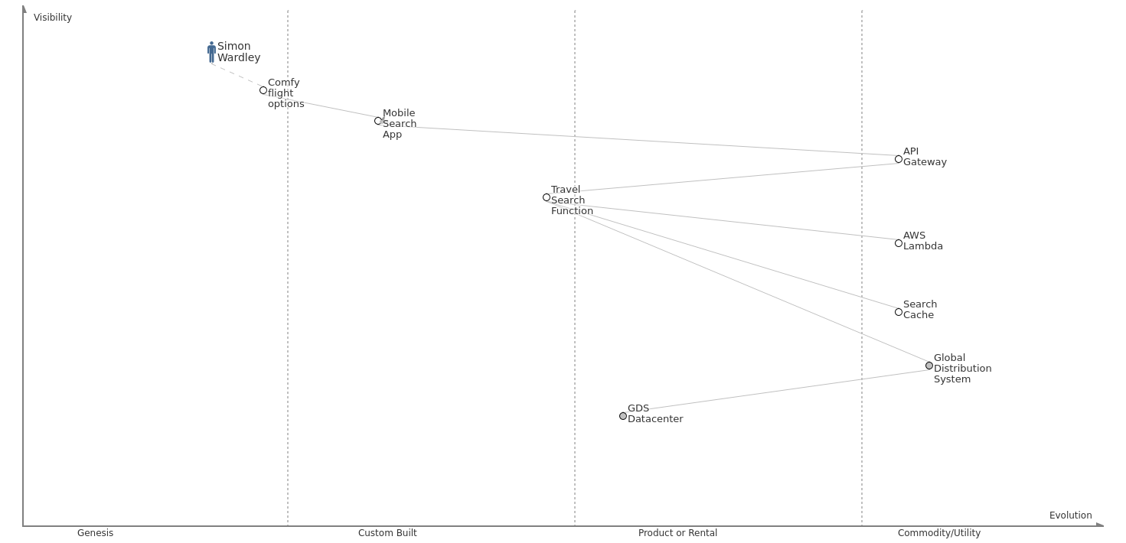
Travel search – serverless
Notes:
New Needs: IoT, analytics, social media monitoring, scale with number of interactions times number of products shipped, predictive modeling

Slide 43
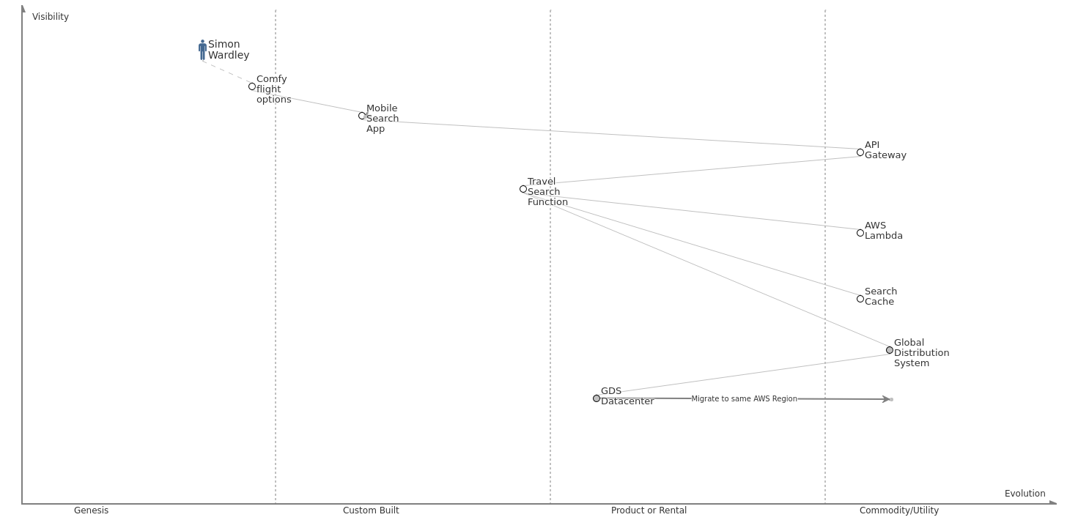
Travel search – GDS optimized network
Notes:
New Needs: IoT, analytics, social media monitoring, scale with number of interactions times number of products shipped, predictive modeling

Slide 44
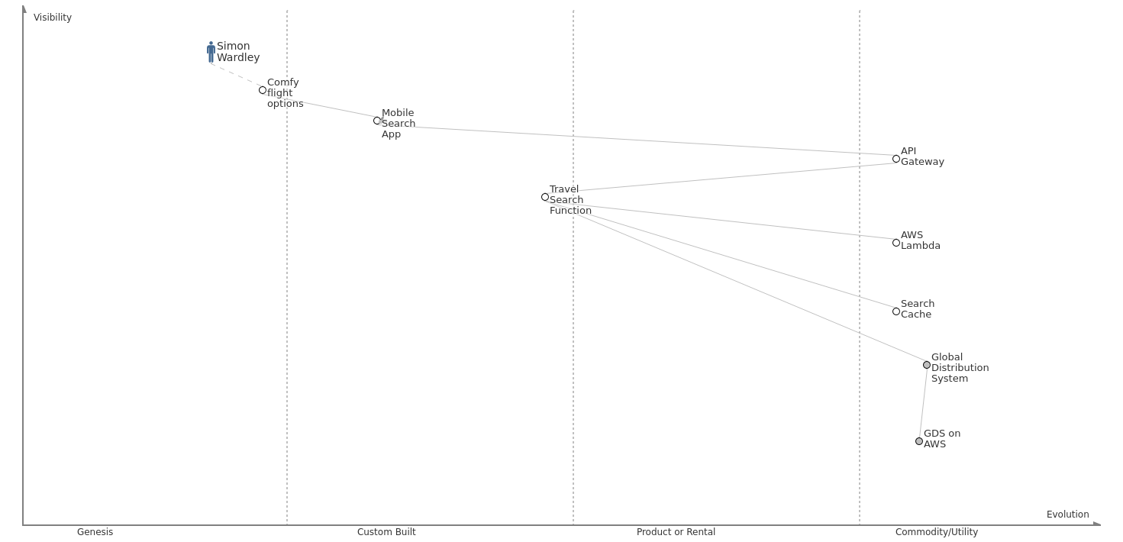
Travel search – happy Simon
Notes:
New Needs: IoT, analytics, social media monitoring, scale with number of interactions times number of products shipped, predictive modeling

Slide 45
Mapping Your Stack
?
Adrian Cockcroft
@adrianco
AWS VP Cloud Architecture Strategy

